Slide 1
Baltimore Drupal Camp
Welcome
Oct. 9th 2015

Slide 2
Come get sticker like this one
Revolutions start one snowflake at a time
In dribs and drabs we will change the world

Slide 3
Optimizing Drupal out the Wazoo elmsln.org @btopro #purespeed

Slide 4
https://github.com/elmsln/elmsln https://elmsln.org
Star, Follow and Fork!

Slide 5
Project Lead
ELMS Initiative
Instructional Systems Architect
E-Learning Institute
College of Arts & Architecture
Penn State University
@btopro (aka Bryan Ollendyke)

Slide 6
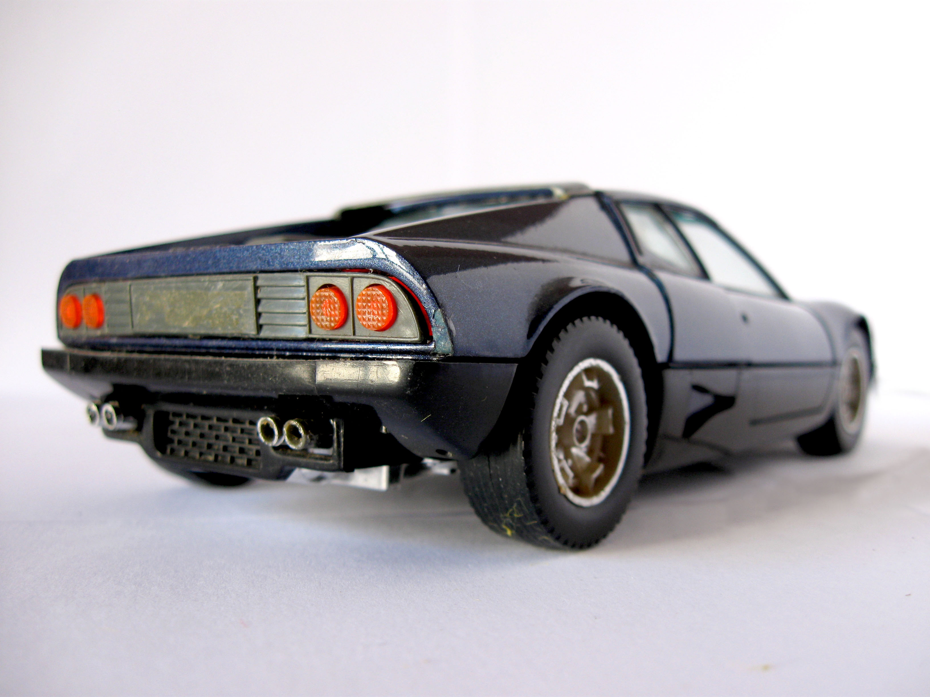
#purespeed
Tools to identify problems / needs
Yslow / PageSpeed / webpagetest.org
New Relic
Devel / XHProf / core hacking
General Server Optimization
Apache
PHP / Zend Opcache / APC/u
MySQL
Varnish / Pound
Drupal Optimization
Cache Bin Management
Core Patching
Contrib (entitycache httprl advagg apdqc authcache dslm httprl_spider)

Slide 7
Cheat on the test
https://github.com/elmsln/elmsln
https://github.com/elmsln/elmsln/tree/master/docs
Has the standard settings I apply to each file broken out per file
Sane defaults for almost anything

Slide 8
The dreaded inherited site
Barebones CentOS 6.x box with enough to run open atrium
No optimizations and definitely things need fixed
http://pure.speed/

Slide 9
Front end performance

Slide 10
Front end performance
Yslow
Firefox / Chrome plugin by Yahoo

Slide 11
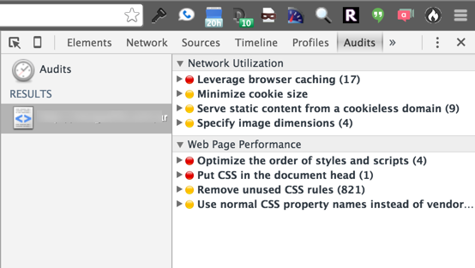
Front end performance
PageSpeed
Chrome, right click -> inspect element -> Audits
Select Reload page and Audit on Load -> Run

Slide 12
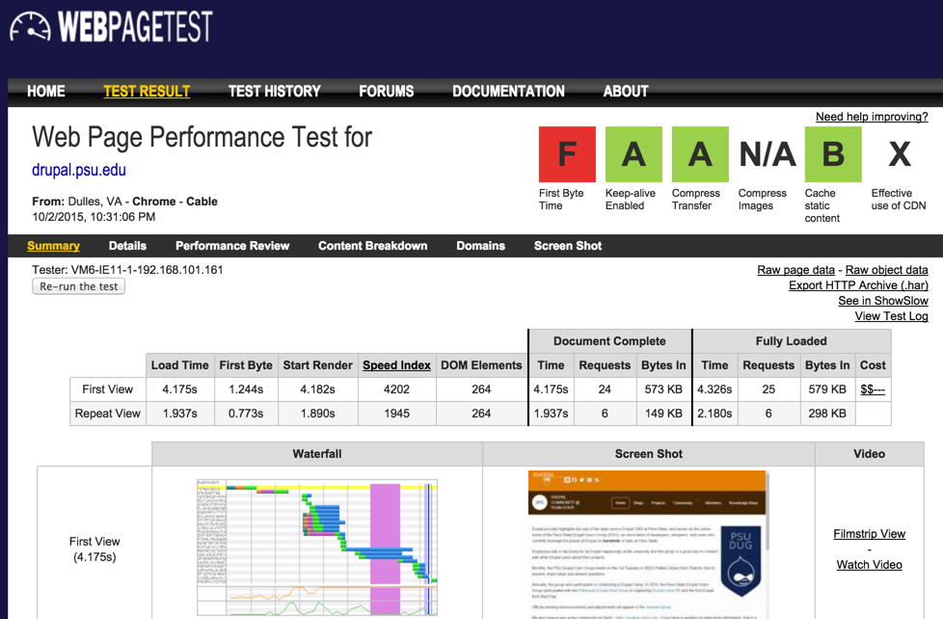
Front end performance
Webpagetest.org

Slide 13
Asset Delivery
Deliver assets logically
Etags that make sense
Expire headers that make sense (far in the future for static assets)
Logical headers = less requests on future page loads
Which makes Apache happy
Your users happy!

Slide 14
JS / CSS blocking
AdvAgg
https://www.drupal.org/project/advagg
Turn on modify and bundler sub-modules
Push for 2 groupings of css / js on bundler settings page
Modifier
Basically check everything that doesn’t sound evil
Use modify to push js into the bottom of the page
Careful, JS needs to be well formed!
Experimental!
Use javascript to load CSS
It’s in the bottom of the advagg modifier settings

Slide 15
Fixing CDN category
All systems complain about CDN till you define what CDN is!
Ways to fix
Buy a legit CDN and pay a lot of money
Install https://www.drupal.org/project/cdn (illegitimate CDN)
Use settings in jquery_update module to deliver from Google / Microsoft
If on bootstrap, select CDN for code source
Use https://www.google.com/fonts for custom font CSS instead of local

Slide 16
Make less requests
AdvAgg / aggregate CSS/JS files can help
https://www.drupal.org/project/advagg
Convert small images to sprites or “data” objects
https://www.drupal.org/project/css_emimage
Good luck though..
You’re using a modular CMS / framework!

Slide 17
Free / Local digging
Drupal.org/project/devel
Enable and set to display results of queries / memory usage
Hack Core
Throw a dpm() into module_invoke_all
https://drupal.psu.edu/blog/post/memory-profiling-hooks
XH-Prof
https://www.drupal.org/project/xhprof
Stand alone php profiler w/ drupal integration

Slide 18
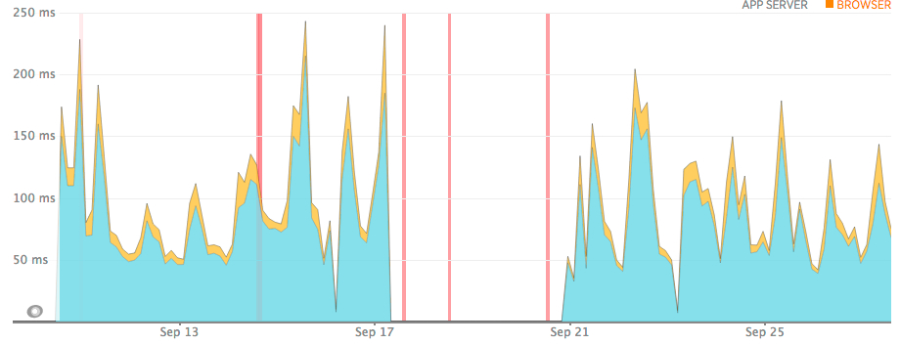
Big Data
Ability to trace errors deeply
Drupal specific breakdowns
Example
https://www.drupal.org/node/2370309#comment-10368929

Slide 19
Server configuration
ELMSLN has automated installers on different flavors
CentOS 6.7, 7.x, Ubuntu 12, AWS image
https://github.com/elmsln/elmsln/tree/master/scripts/install/handsfree
CentOS 6.7
https://github.com/elmsln/elmsln/blob/master/scripts/install/handsfree/centos/centos-install.sh
Pick through the script to see examples of upgrading / tuning each piece

Slide 20
Server: Apache
Important aspects
Compression – send less w/ the same result
Etags – strip off so validation of resource match happens
Expires headers – ensure static assets are kept far into the future
Keep Alive – create less apache workers by keeping them open longer
MaxClients – set appropriately or server will die
memory per page / (RAM – other services) = MaxClients
Cheating - ZZZ_Performance.conf
Drop in performance gain for almost any drupal / apache site

Slide 21
Server: PHP
PHP -- /etc/php.ini or /etc/php5/fpm/php.ini
Zend Opcache -- /etc/php.d/opcache.ini or /etc/php5/mods-available/opcache.ini
APC/u - /etc/php.d/apc.ini or /etc/php5/mods-available/apcu.ini
https://drupal.psu.edu/blog/post/purespeed-php-tuning
Cache code files in memory
Otherwise memory used to deliver insane!
PHP 5.5+ use Zend OpCache
APCu if you want as cache backend
PHP < 5.4 use APC
user bin for backend builtin
Biggest deal in mcarper’s opinion
realpath_cache_size = 1M
realpath_cache_ttl = 3600

Slide 22
Server: MySQL
MySQL - /etc/my.cnf
Configuration:
Most common issue:
max-allowed-packet = 32M
Disable caching engine (counter intuitive but Drupal makes this worthless)
Ensure innodb table encoding, and tuned
Drupal Contrib:
APDQC – drupal.org/project/apdqc
Replacement for Core mysql cache bin engine
Eliminates deadlocks
Gives report on how to further optimize your server
Use other alternate cache backends (so mysql does less)

Slide 23
Server: MySQL OLD_PASSWORD
Caution for those upgrading older systems (MySql 5.1 or older)
4.x versions had 16 bit passwords, now they are 40
There is no upgrade path for user accounts w/ this issue
So make sure you know all the passwords on the box if you experience it
DROP USER USERNAME@localhost;
CREATE USER USERNAME@localhost IDENTIFIED BY 'PASSWORD';
GRANT ALL PRIVILEGES ON DATABASE.* TO USERNAME@localhost;
For multisites / multiple aliases:
drush @sites eval 'global $databases; print $databases["default"]["default"]["database"] . " " . $databases["default"]["default"]["username"] . " " . $databases["default"]["default"]["password"] . "\n"'

Slide 24
Server: Varnish / Pound
Varnish - /etc/varnish/default.vcl
yum install varnish
Reverse Proxy that sits in front of apache
Listen on 80; move apache to port 8080
must have for anonymous traffic / high scale
Can’t handle HTTPS (without 4.x + plugin)
Pound - /etc/pound.cnf
yum install pound
Load balancer
Sits in front of Varnish / apache
Can handle HTTPS, hands off as HTTP

Slide 25
Drupal / Server
httprl_spider
https://www.drupal.org/project/httprl_spider
Usage:
drush @site hss node (request all nodes on the site)
Great for seeding anonymous user page caches
Stuff in a crontab nightly after cron (so caches are cleared out)
* 4 * * * root drush @mysite cron
15 4 * * * root drush @mysite hss

Slide 26
Drupal: Cache bin management
Cache Bin Management
https://drupal.psu.edu/blog/post/purespeed-cache-bin-backends
Popular options
Apc user bin – great for things that don’t change
Fast, cheap and easy for anyone (don’t push page cache here!)
Filecache – writ to file system for cache data
Great, cheap and easy if on SSD
Memcache –popular in distributed / complex setups
Reddis – similar to memcache, newer and more popular now
Both great but usually you want this on its own server / more complicated
Apdqc – replacement for mysql core cache bin mechanism
Run on any site

Slide 27
Drupal: Cache bin WARNING
Make sure file paths are correct!
WSOD
Cache_form CAN NOT live in bins
All page form submission breaks
APC fragmentation
Restart apache on interval
APDQC recommendations
Some involve mysql upgrades
Semephor / session replacements
can cause issues

Slide 28
Drupal Core Patches
https://drupal.psu.edu/blog/post/purespeed-core-patching
Most of these will get in D7 at some point in time
Most improvement seen in authenticated sessions
ELMSLN runs one from article in production

Slide 29
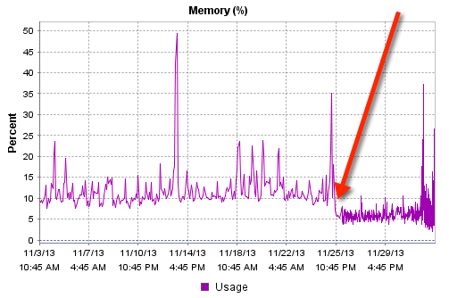
Drupal – DSLM
https://www.drupal.org/project/dslm
https://drupal.psu.edu/blog/post/dslm-multi-sites-steroids
Manage multisites / versioning through symlinks
More performant then managing multiple copies of core

Slide 30
Drupal - entitycache
https://www.drupal.org/project/entitycache
Core in drupal 8!
Caches entity / object definitions (basically required for field collections)
Turn it on, that’s it!

Slide 31
Drupal - APC
drupal.org/project/apc -Exposes APC user bin as a cache backend
Beware of fragmentation
Can’t be used in a distributed / clustered deployment (use memecache / reddis)
$conf['cache_backends'][] = 'sites/all/modules/apc/drupal_apc_cache.inc';
$conf['cache_class_cache'] = 'DrupalAPCCache';
$conf['cache_class_cache_admin_menu'] = 'DrupalAPCCache';
$conf['cache_class_cache_block'] = 'DrupalAPCCache';
$conf['cache_class_cache_bootstrap'] = 'DrupalAPCCache';
$conf['cache_class_cache_entity_file'] = 'DrupalAPCCache';
$conf['cache_class_cache_field'] = 'DrupalAPCCache';
$conf['cache_class_cache_menu'] = 'DrupalAPCCache';
$conf['cache_class_cache_libraries'] = 'DrupalAPCCache';
$conf['cache_class_cache_token'] = 'DrupalAPCCache';
$conf['cache_class_cache_views'] = 'DrupalAPCCache';
$conf['cache_class_cache_path_breadcrumbs'] = 'DrupalAPCCache';
$conf['cache_class_cache_path'] = 'DrupalAPCCache';
$conf['cache_class_cache_book'] = 'DrupalAPCCache’;

Slide 32
Drupal - HTTPRL
Drupal.org/project/httprl
Threading capable
Allows for queuing background threads and non-blocking calls
Similar to Guzzle (D8 core)
Makes certain projects faster (like advagg)
Can be a bit of a troublemaker
https://drupal.psu.edu/blog/post/bench-marking-non-blocking-httprl-vs-drupalhttprequest
https://drupal.psu.edu/blog/post/core-caching-and-drupalstatic-make-cached-drupalhttprequests

Slide 33
Drupal - advagg
Drupal.org/project/advagg
Covered earlier
Should be on every site you do
Biggest gains in compression, bundler, async font loader and pushing js to footer
Great for improving perception of page load
Beware of bricking JS though

Slide 34
Drupal - APDQC
Covered earlier
Install, read README and status page
Fix issues it reports
Faster site with less time spent in mysql calls

Slide 35
Drupal - Authcache
drupal.org/project/authcache
Aggressive caching methods for authenticated users
Great when granularity of access is per role
Caches per combination of roles (handles anonymous too)
Can cache admin, not recommended
Need to modify settings.php / authcache.php in Drupal root
https://github.com/elmsln/elmsln/blob/master/core/dslmcode/shared/drupal-7.x/modules/ulmus/authcache/modules/authcache_p13n/safe_frontcontroller/authcache.php

Slide 36
Drupal – Authcache Notes
Figure out a combination that works for you then make it a feature
We run same feature all over the place
Easy to support additional custom granularities
ELMSLN supporting “sections” is 3 lines in implemented hook
Enable almost everything
ESI only works with configuration to Varnish (I don’t have this working)
AJAX easier to support / configure
Do lots of testing before rolling with this
Has a debug mode that can be enabled for ALL traffic
Helps iron out when things don’t cache

Slide 37
Questions
@btopro
elmsln.org

